Slide 1
Attendee-Sourcing
Anant Bhardwaj (MIT)
Juho Kim (MIT)
Steven Dow (CMU)
David Karger (MIT)
Sam Madden (MIT)
Rob Miller (MIT)
Haoqi Zhang (Northwestern)
Notes:
Which is collecting useful data from conference attendees like you to do cool stuff!

Slide 2
how to collect inputs
from
members with different roles
in a community
to
help in real-world problems
Notes:
Formally this is a design space exploration of how to collect inputs from members with different roles in a community
here the community happens to be a conference community
to help in real-world problems and the problem we address is the problem of conference scheduling

Slide 3
CONFERENCE SCHEDULING
CHI – a large conference on Human-Computer Interaction
4 days
More than 500 papers
16 parallel sessions

Slide 4
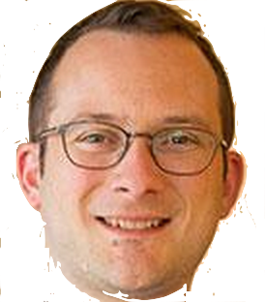
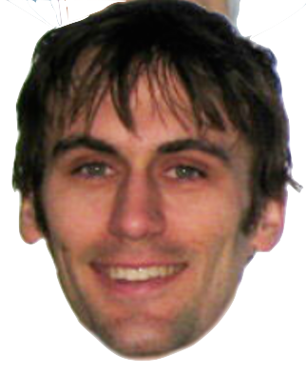


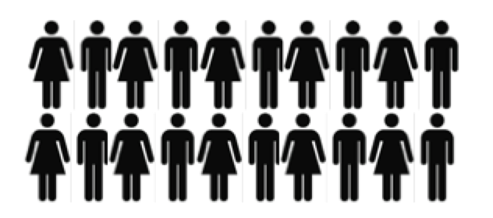
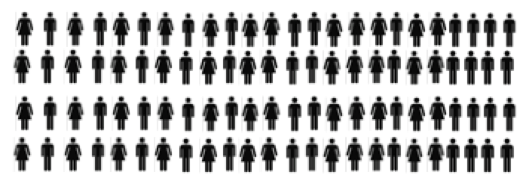
a Conference Community [HCOMP 2014]
Conference Chairs (2)
2. PC Members (31)
3. Authors (50+)
4. Attendees (150+)
Notes:
Notice that different community groups exist in any conference community

Slide 5
CHI 2014
Conference Chairs (4)
2. PC Members (150+)
3. Authors (1000+)
4. Attendees (2500+)

Slide 6
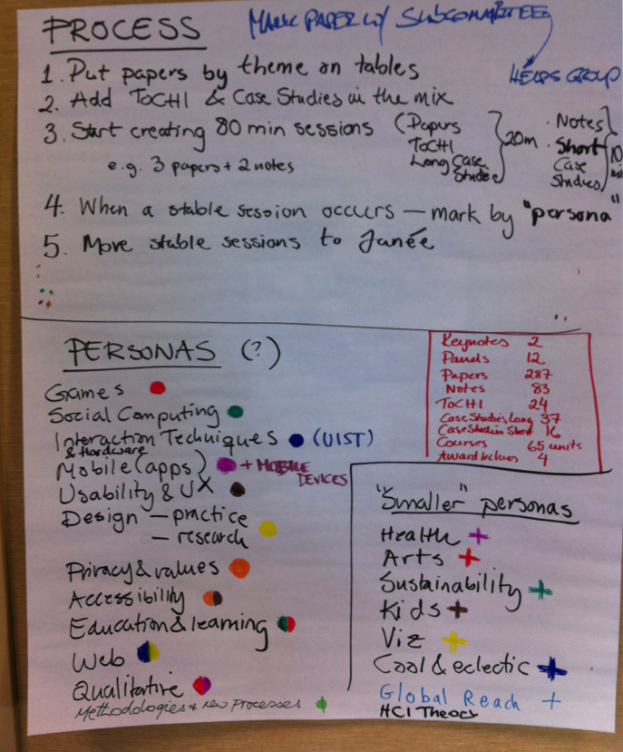
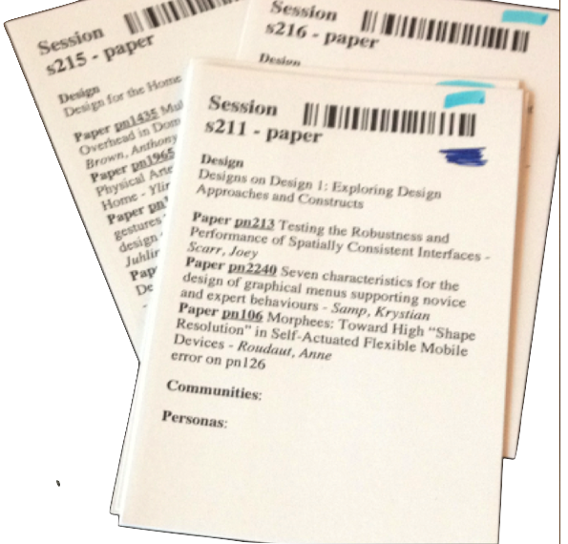
Paper Based Process
Notes:
Group similar papers by themes and create sessions.

Slide 7
Notes:
The outcome of the process is a rough preliminary schedule created by program committees

Slide 8
Paper based process
Groups involved in the process
Chairs / Organizers
PC Members
Authors
Attendees

Slide 9
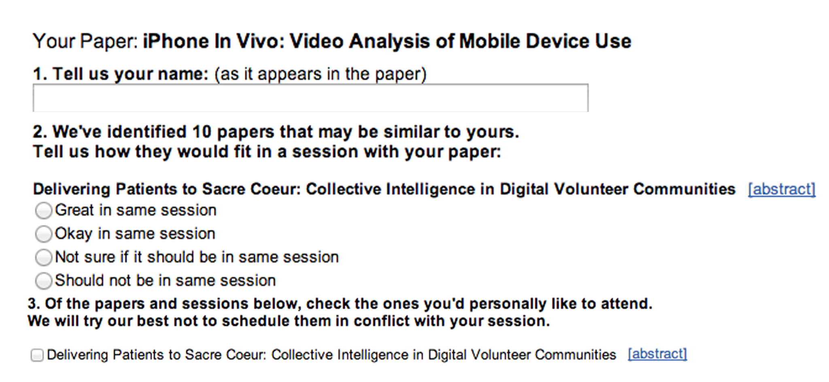
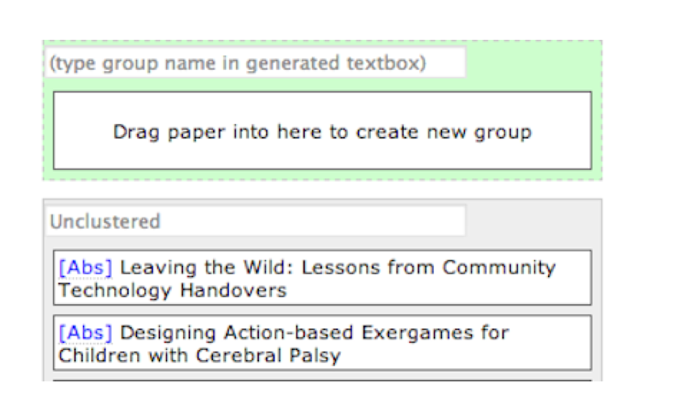
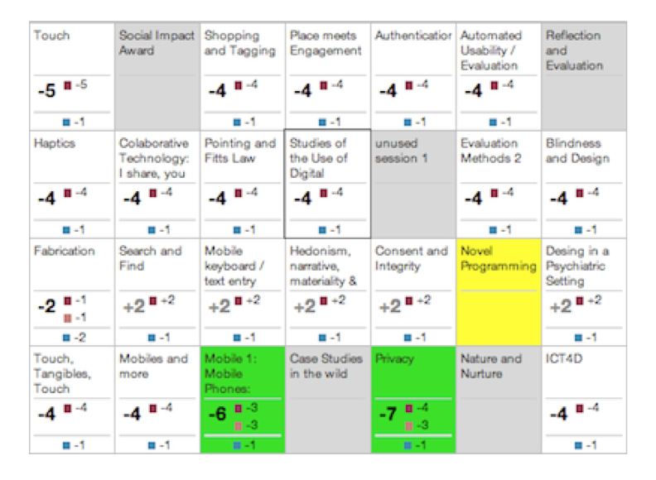
Prior Work [Cobi]
2. Author-Sourcing
Committee-Sourcing
3. Scheduling Interface
Notes:
PC members group similar papers in their area
Authors are sent a questionnaire asking to identify papers are that will fit well in the session with their paper and the papers they would like to see.
Conference organizers use the scheduling interface to resolve conflicts

Slide 10
Research Question
Groups involved in the Cobi process
Chairs / Organizers
PC Members
Authors
Attendees
Research Question: Is there any benefit in involving attendees in the process?

Slide 11
Attendee-Sourcing
Challenge
Attendees have no direct interest/incentive
Proposed Solution
Give attendees a tool that they use for their own benefits and we collect useful data as a by-product of their usage of the tool.
Notes:
Collect useful data from attendees to help in conference schduling

Slide 12
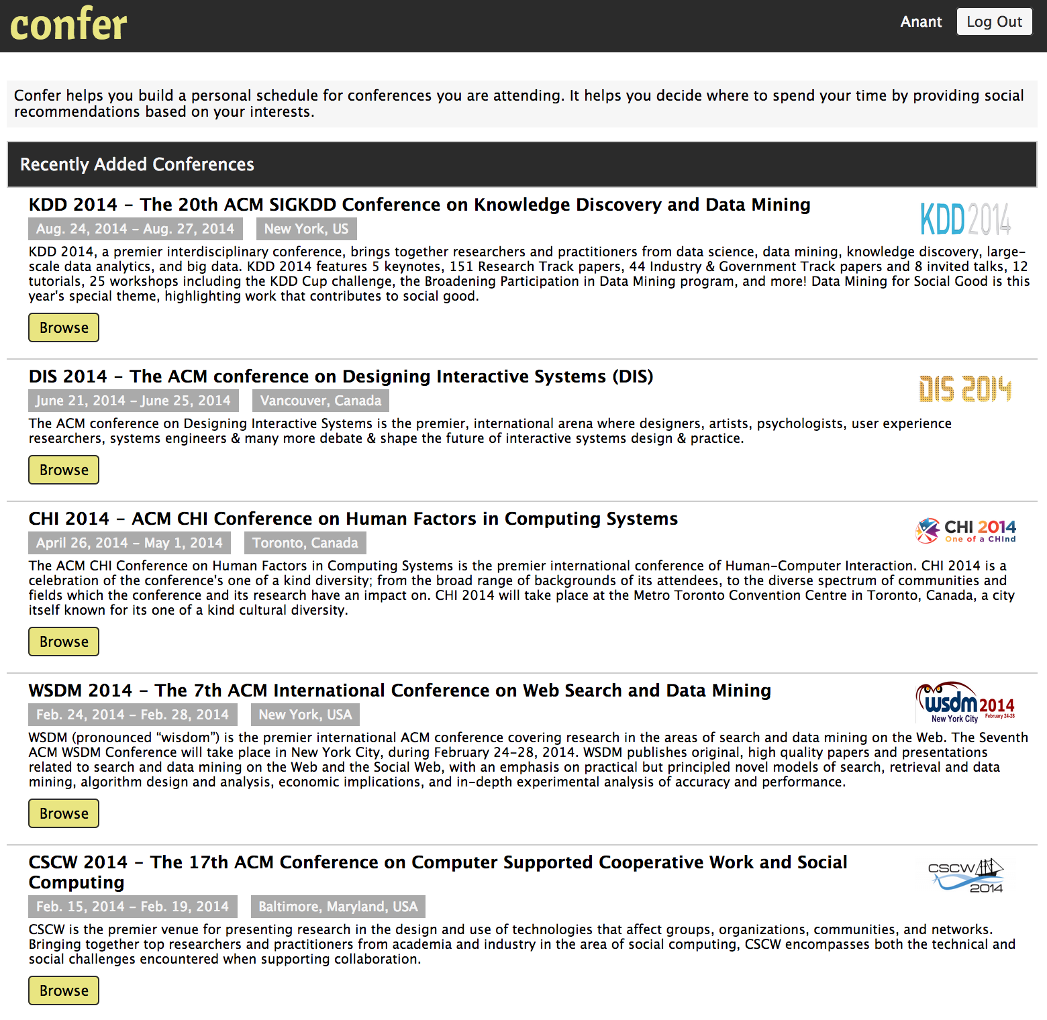
Confer
Confer helps attendees find/explore interesting papers and build a personal schedule.

Slide 13
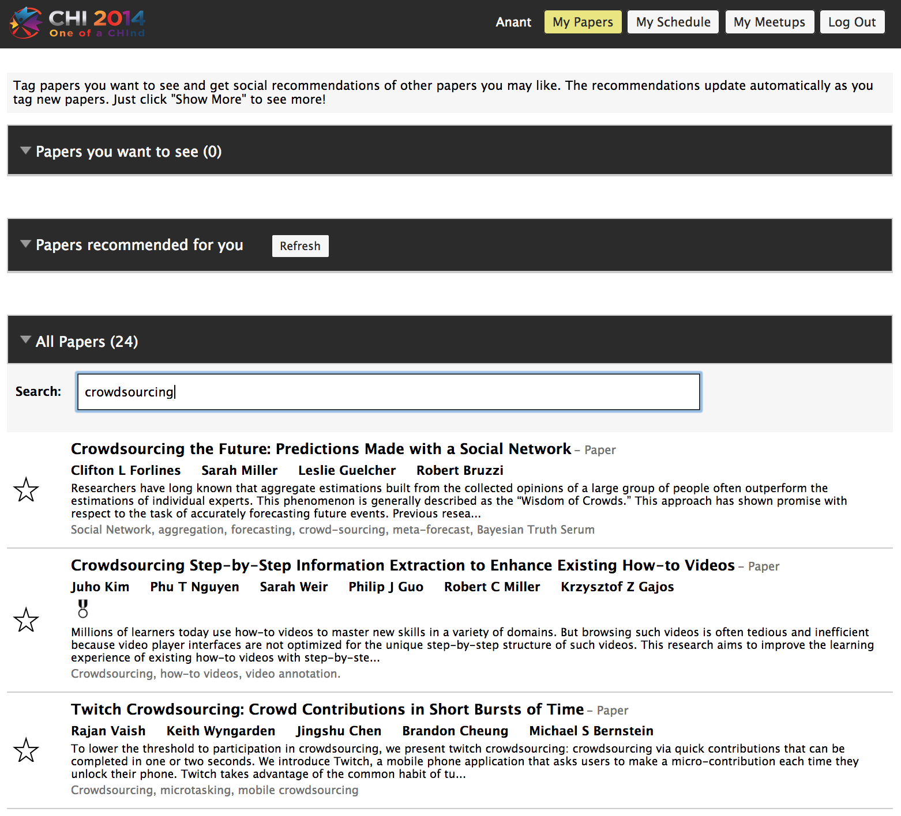
Attendees Search on Confer

Slide 14
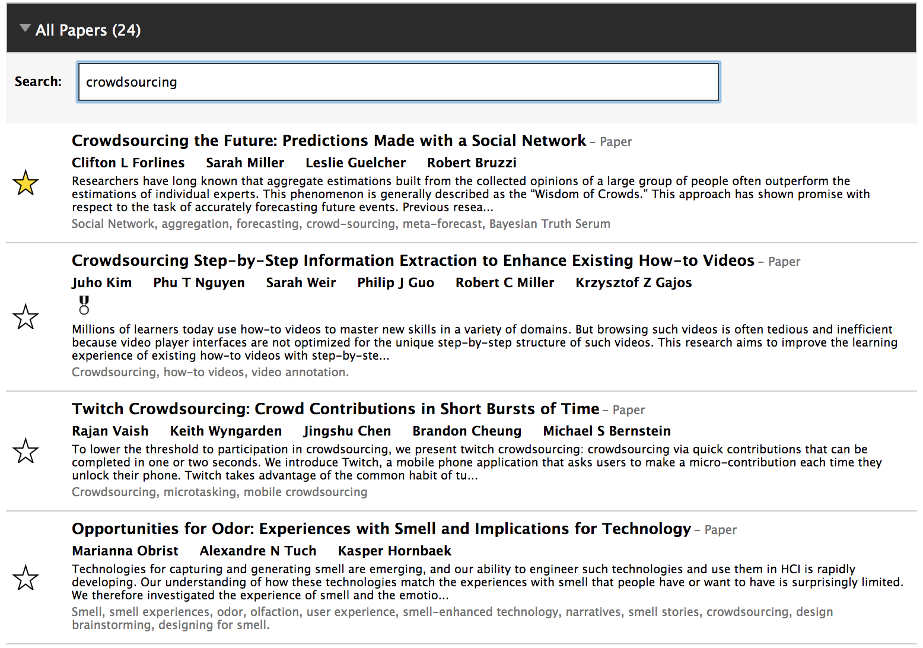
ATTENDEEES Mark Interesting Papers

Slide 15
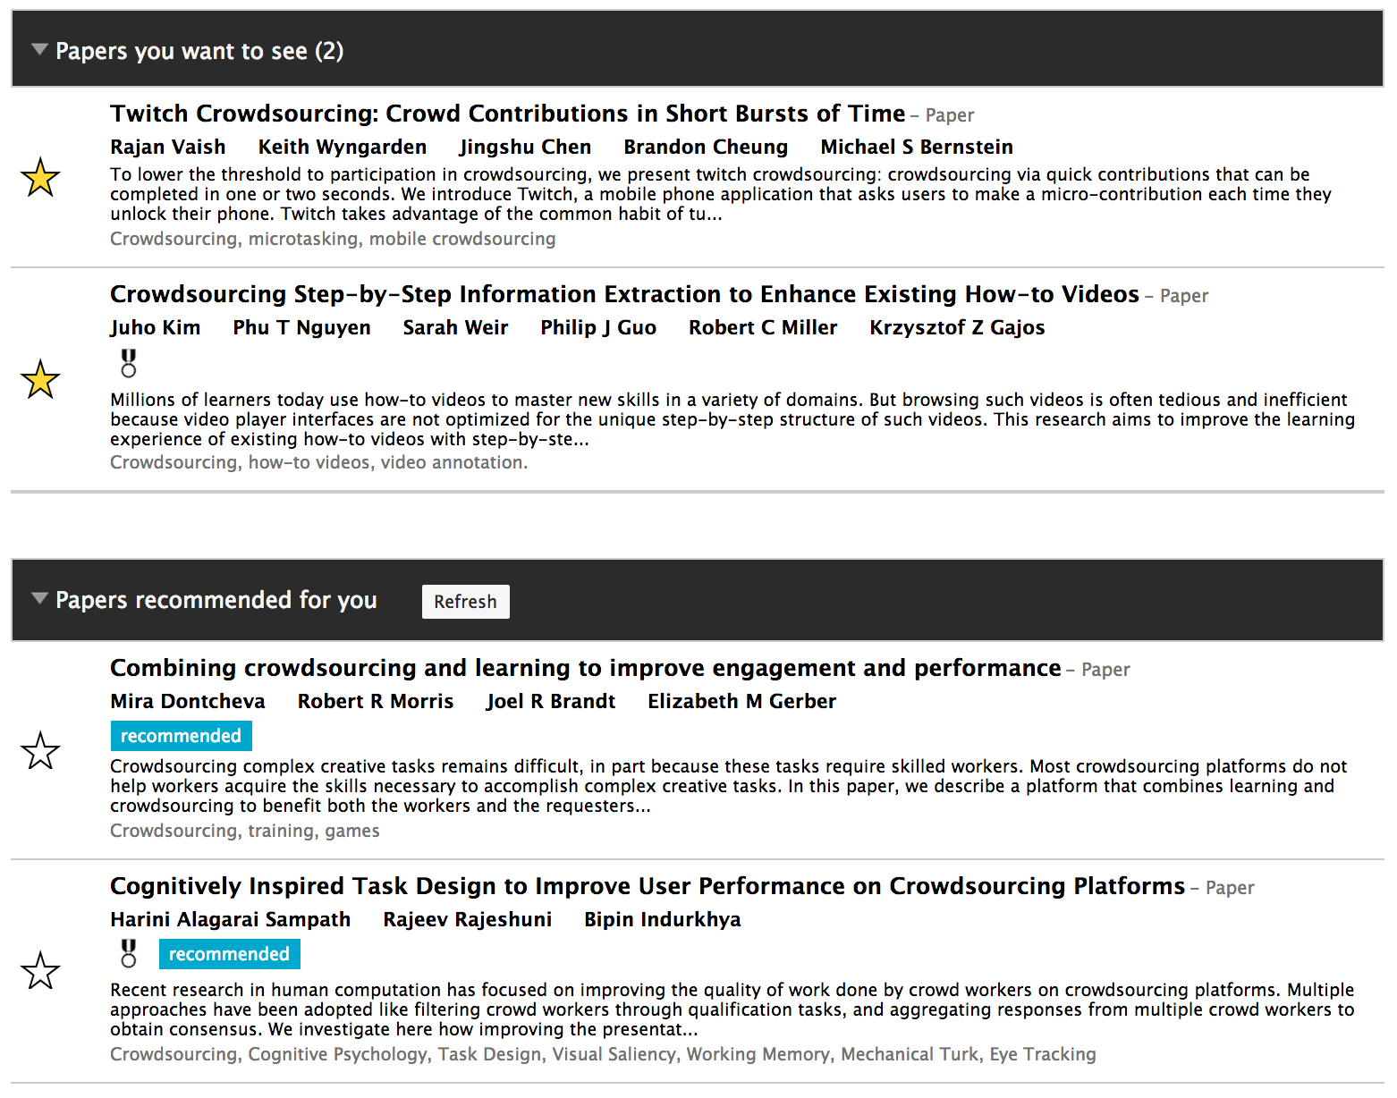
Recommendations

Slide 16
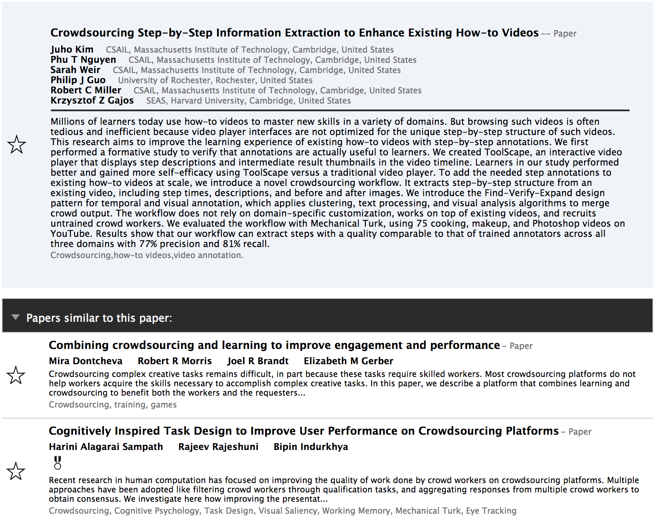
ATTENDEES EXPLORE

Slide 17
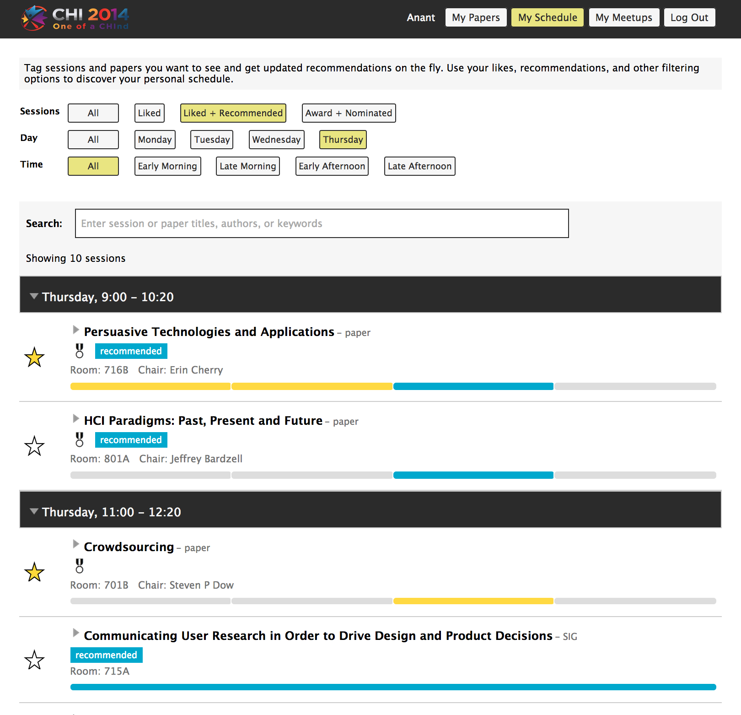
PERSONALIZED SCHEDULE
Notes:
This is the real incentive for attendees why they use Confer – and we get useful data about their preferences

Slide 18
Attendee-Sourcing with Confer
Challenge
Why would an attendee mark papers months in advance to help in conference scheduling?
Lessons from past deployments
Attendees start using Confer immediately once the conference is available on Confer
They search for papers and explore related papers
While exploring, they add interesting papers to their preference list.

Slide 19
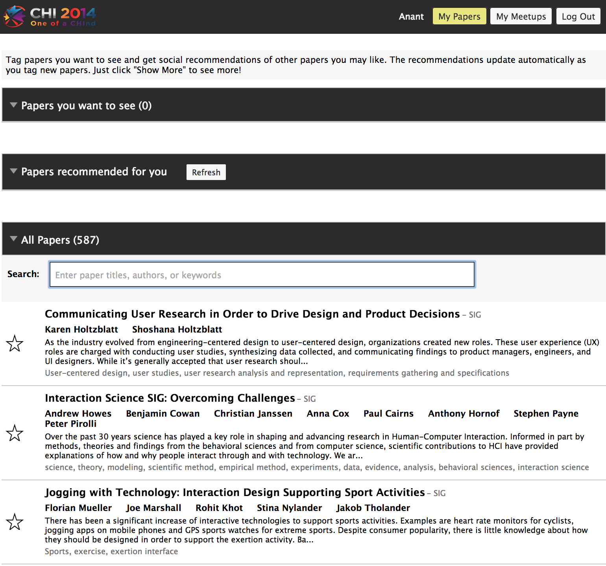
CHI 2014 Deployment
Release the list of accepted papers
1-2 months before the schedule announc-ement
No Schedule

Slide 20
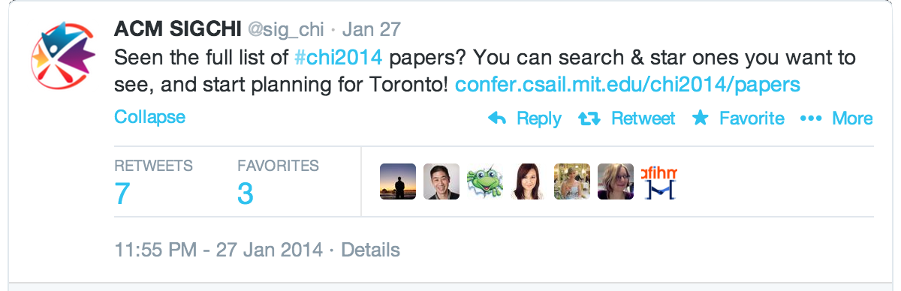
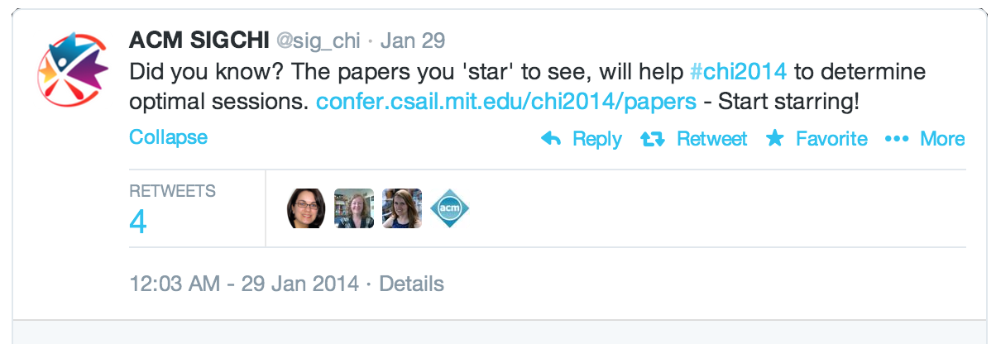
Advertise! Advertise!

Slide 21
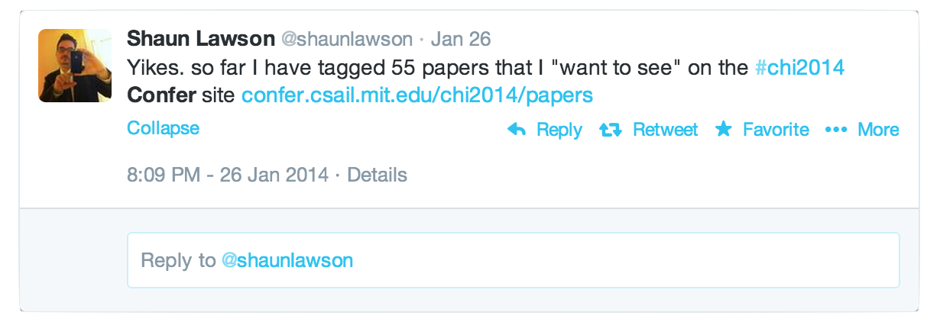
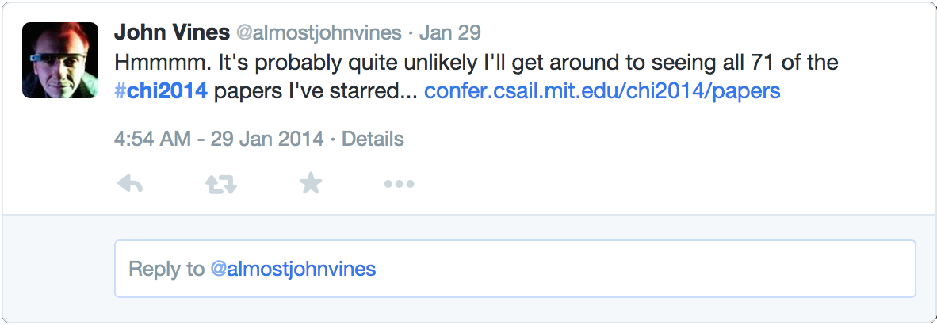
Rich Data (4 months in Advance)

Slide 22
RESEARCH QUESTION
Given that Cobi already collects preferences from authors, is there any benefit in doing attendee-sourcing?

Slide 23
COBI vs. CONFER
Attendees want to see more papers
Confer (mean: 20.83, std-dev: 21.47, median: 14)
Cobi (mean: 6.1, std-dev: 3.86, median: 5)
Confer has less participation but generates more preference data points
Confer (327 attendees: 7,228 preferences)
Cobi (634 authors: 3,869 preferences)

Slide 24
Data Analysis
Majority of related papers were detected as related in both.
Relative Recall
Confer
detected all the related pairs found in Cobi
Cobi
did not detect many related pairs found in Confer

Slide 25
Nature of Data
Cobi validates
High Precision (cost: misses a lot on recall)
Personal Bias: my paper in a good session
Confer discovers
Data: the by-product of a natural exploration by attendees
High Recall (cost: some false positives)
Possible Biases: social media, popularity
Confer & Cobi complement each other

Slide 26
CHI 2014 [Confer + COBI]
CHI 2014 used data collected from both Cobi & Confer
Creating Sessions & reducing conflicts
A set of papers a lot of attendees want to see
put in the same session
avoid conflicts: don’t schedule in parallel

Slide 27
TAKEAWAYS
There is value in engaging all the community members
Different incentives, methods, and interfaces are needed for collecting data from different layers of a community.
Members with different roles and incentives produce data of different nature

Slide 28
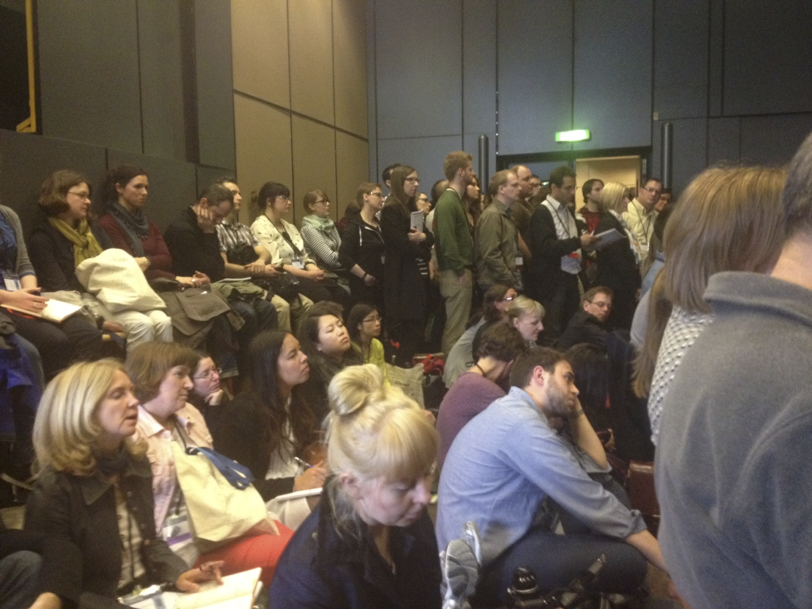
Confer: Beyond Scheduling
Rooms
put popular papers in bigger rooms
Notes:
Popularity estimation is another aspect of scheduling as it is important to put talks in a room of right size.

Slide 29
Confer: Beyond Scheduling
Panels, workshops, keynote speakers, etc.
Understand trends, community network, etc.

Slide 30
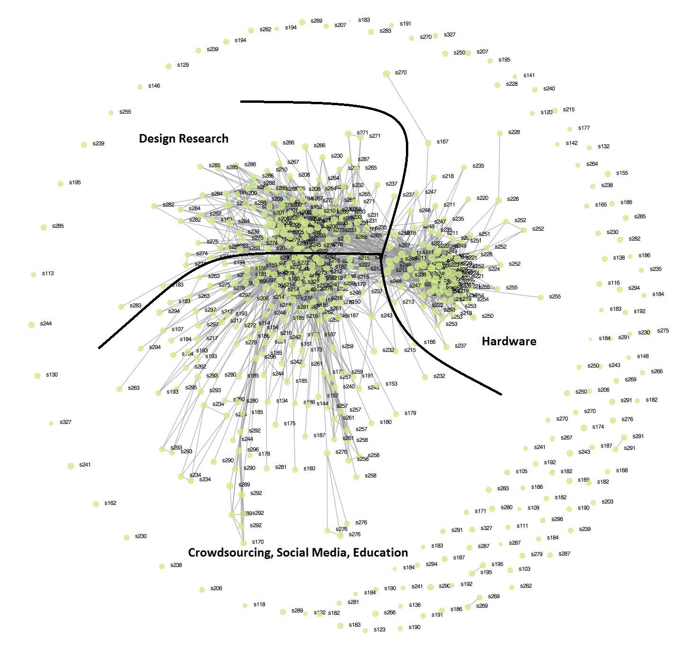

Slide 31
Summary
Collect inputs from different groups in a community for real-world problems
Different incentives, methods, and interfaces are needed for collecting data from different groups
Different groups produce data of different nature
http://confer.csail.mit.edu

